Slide 1
Servlets and JSP

Slide 2
Outline
Overview of Web Application
HTTP Methods and Responses
Lifecycle of Web Servlets
Writing Servlet programs with Servlet APIs
Reading and Processing Forms
Handling GET/POST Requests
Database connectivity through servlets
Cookies and Sessions

Slide 3
Web Application
Application is a large program or we can also say a collection of functions.
A web application is a computer program that utilizes web browsers and web technology to perform tasks over the internet.
Web applications are usually coded in browser-supported language such as JavaScript and HTML as these languages rely on the browser to render the program executable.
The web application requires a web server to manage requests from the client, an application server to perform the tasks requested, and, sometimes a database to server the information.

Slide 4
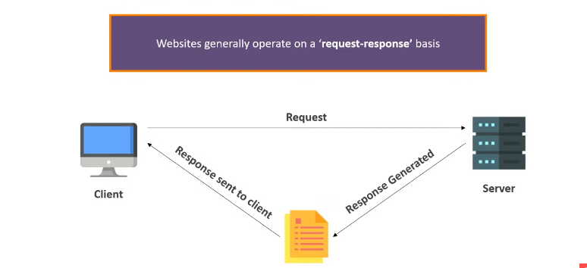

Slide 5
Benefits of Web Application
Web applications run on multiple platforms regardless of OS or device as long as the browser is compatible.
All users access the same version, eliminating any compatibility issues.
They are not installed on the hard drive, thus eliminating space limitations.
They reduce software piracy in subscription-based web applications(i.e. SaaS)
They reduce costs for both the business and end user as there is less support and maintenance required by the business and lower requirements for the end user’s computer.

Slide 6
The HTTP(Hypertext Transfer Protocol) Protocol
The HTTP is an application layer protocol that allows web-based applications to communicate and exchange data using request/response cycle.
The HTTP is the messenger of the web.
It is a TCP/IP based protocol.

Slide 7
HTTP Methods
The primary or most commonly-used HTTP methods are POST, GET, PUT and DELETE.
These methods correspond to create, read, update and delete(or CRUD) operations, respectively.
There are a number of other methods too, but they are utilized less frequently.

Slide 8
GET
The HTTP GET method is used to read(or retrieve) a representation of a resource.
GET requests are used only to read data and not change it. So, they are considered safe.
Example: jsonplaceholder.typicode.com/comments?postId=1
Browsers in default make GET request.
You can easily test GET request using browser.

Slide 9
Post
The POST method submits an entity to the specified resource, often causing a change in start or side effects on the server.

Slide 10
DELETE
If a DELETE method is successfully applied, there are several response status codes possible:

Slide 11
PUT
The HTTP PUT request method creates a new resource or replaces a representation of the target resource with the request payload.
The difference between PUT and POST is that PUT is idempotent: calling it once or several times successively has the same effect(that is no side effect), whereas successive identical POST requests may have additional effects, akin to placing an order several times.

Slide 12
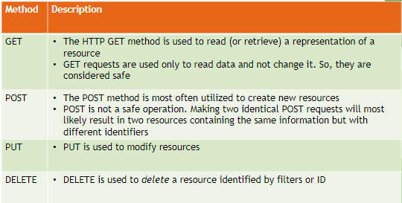
HTTP Methods

